Slide 1
DSTAR
Digital Smart Technology for Amateur Radio
Digital basics
What is DSTAR
What can DSTAR do
DSTAR radio features
Send/receive pictures
Radio remote control
Data
DR Mode
Update memories
Hotspots
New radios
John Davis WB4QDX
wb4qdx@arrl.net

Slide 2
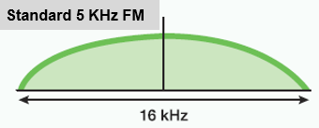
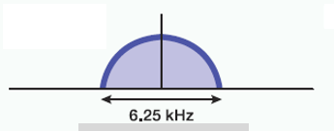
Digital Basics
Voice (analog) is converted to data (1s and 0s)
Data (text, etc.) may be added to voice to produce a single data stream containing voice and data
Radio is modulated as a data carrier
Occupied bandwidth is determined by data bit rate and type of modulation
Generally, digital voice and data occupies less spectrum than analog FM@16 KHz (D-STAR, NXDN@6.25 KHz, DMR@7.6 KHz, Fusion digital@9.36 KHz
DSTAR

Slide 3
Digital Behavior
Digital voice does not gradually degrade in quality as signal level decreases

Slide 4
What is D-STAR?
One of several digital modes used in Amateur Radio
D-STAR is an open standard for digital voice and data designed specifically for Amateur Radio
Developed originally by Japan Amateur Radio League (JARL) with Icom and Kenwood
DSTAR radios do voice, data, pictures and position reporting
Radios manufactured by Icom and Kenwood (all do FM and DSTAR)
Hotspots allow voice and data access to D-STAR via Internet connection (similar to EchoLink)
Reflectors act as conference bridge for linking multiple repeaters (DPLUS, DCS and XRF Reflectors in operation worldwide) with linking is under user control on radio

Slide 5
DSTAR Radio Features
Most have internal GPS for location display and finding nearby repeaters
Contains internal database of repeaters (FM and DSTAR on current models)
Micro SD card stores memories, repeater lists, GPS locations stored voice
Built-in data interface or internal sound card for digital modes

Slide 6
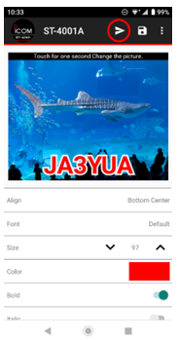
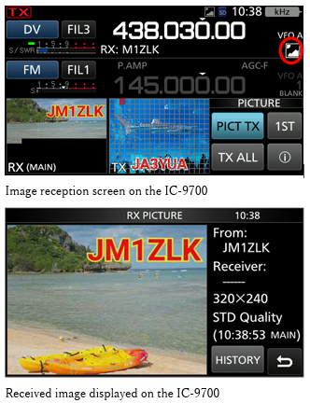
Sending and Receiving Pictures on DSTAR
DSTAR protocol can send and receive pictures in fast data mode
Current generation of Icom radios can display and send pictures on
Kenwood and previous Icom DSTAR radios can send and receive with app
    ST-4001A for Android, ST-4001I for IOS, ST-4001W for Windows
Nets practice sending and receiving pictures
    REF072D/E, REF003A

Slide 7
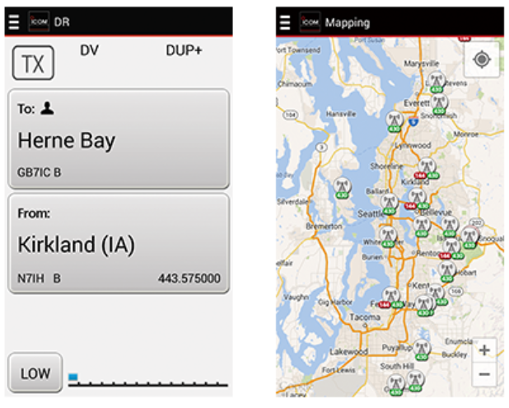
Remote Control of Your Radio
RS-MS1A (Android) and RS-MS1I (IOS) apps allow remote control of radio over Bluetooth or cable
Take pictures on phone and send over DSTAR
Text messaging
Position/mapping display

Slide 8
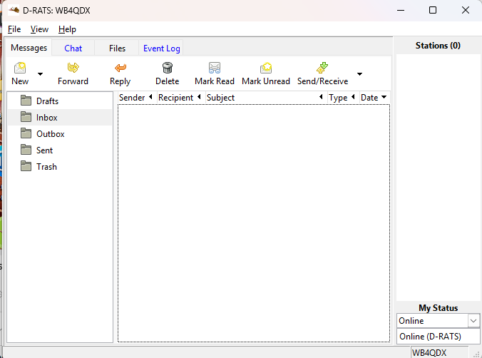
Sending and Receiving Data
DSTAR radios have digital data interface (TX data, RX data, GRD)
Contains ability to send/receive data or GPS info
Programs such as D-RATS allow chat, file transfer and position mapping

Slide 9
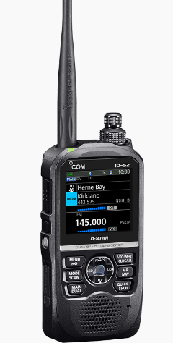
Getting on DSTAR
Program your callsign in radio (callsign is sent in each transmission and displayed on all radios)
Turn on internal GPS and get satellite lock
Select DR Mode (one button)
Selecting “Nearest Repeater” displays nearby repeaters and programs radio from internal database
TALK

Slide 10
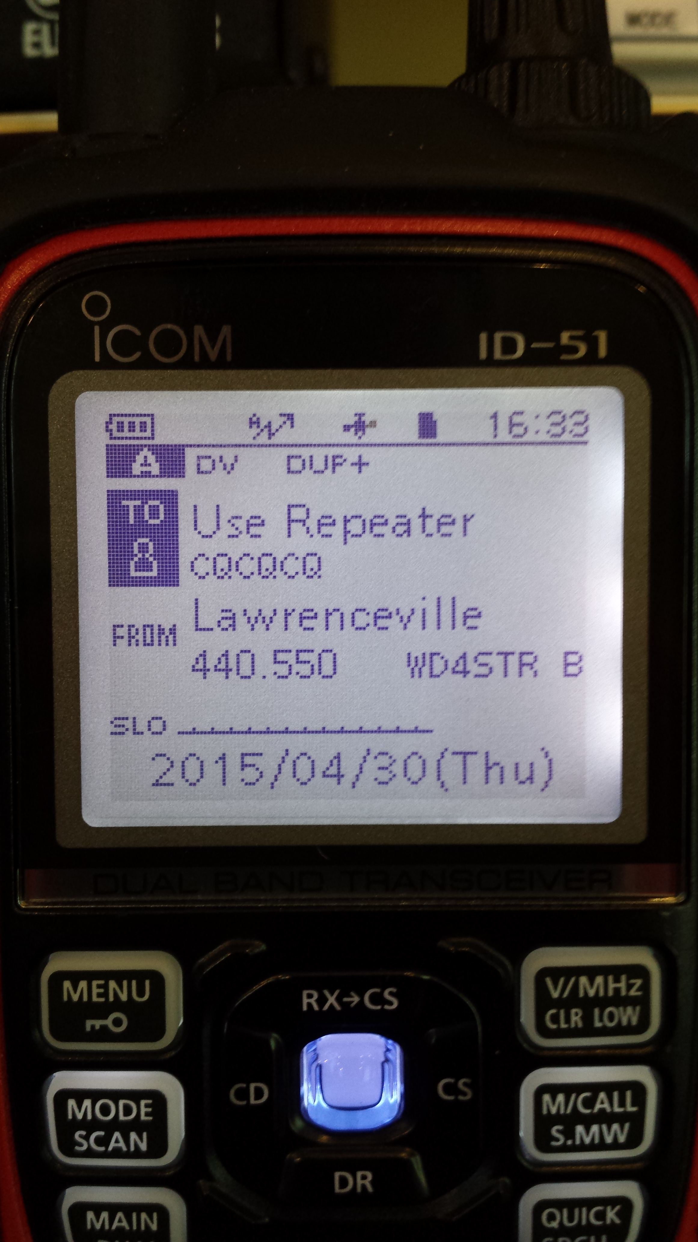
DR Mode – Easiest to Use
DR Mode is Digital Repeater Mode available on radios after 2013
Current generation of radios have two sets of memories
  Regular Memories for traditional frequency storage (Manual method)
  Repeater List is geocoded for location-based lookup
Easy to Use
  Press DR
  Select Source Repeater in FROM field
    Pick by region
    Find Nearest Repeater to current location
  Select function in TO field

Slide 11
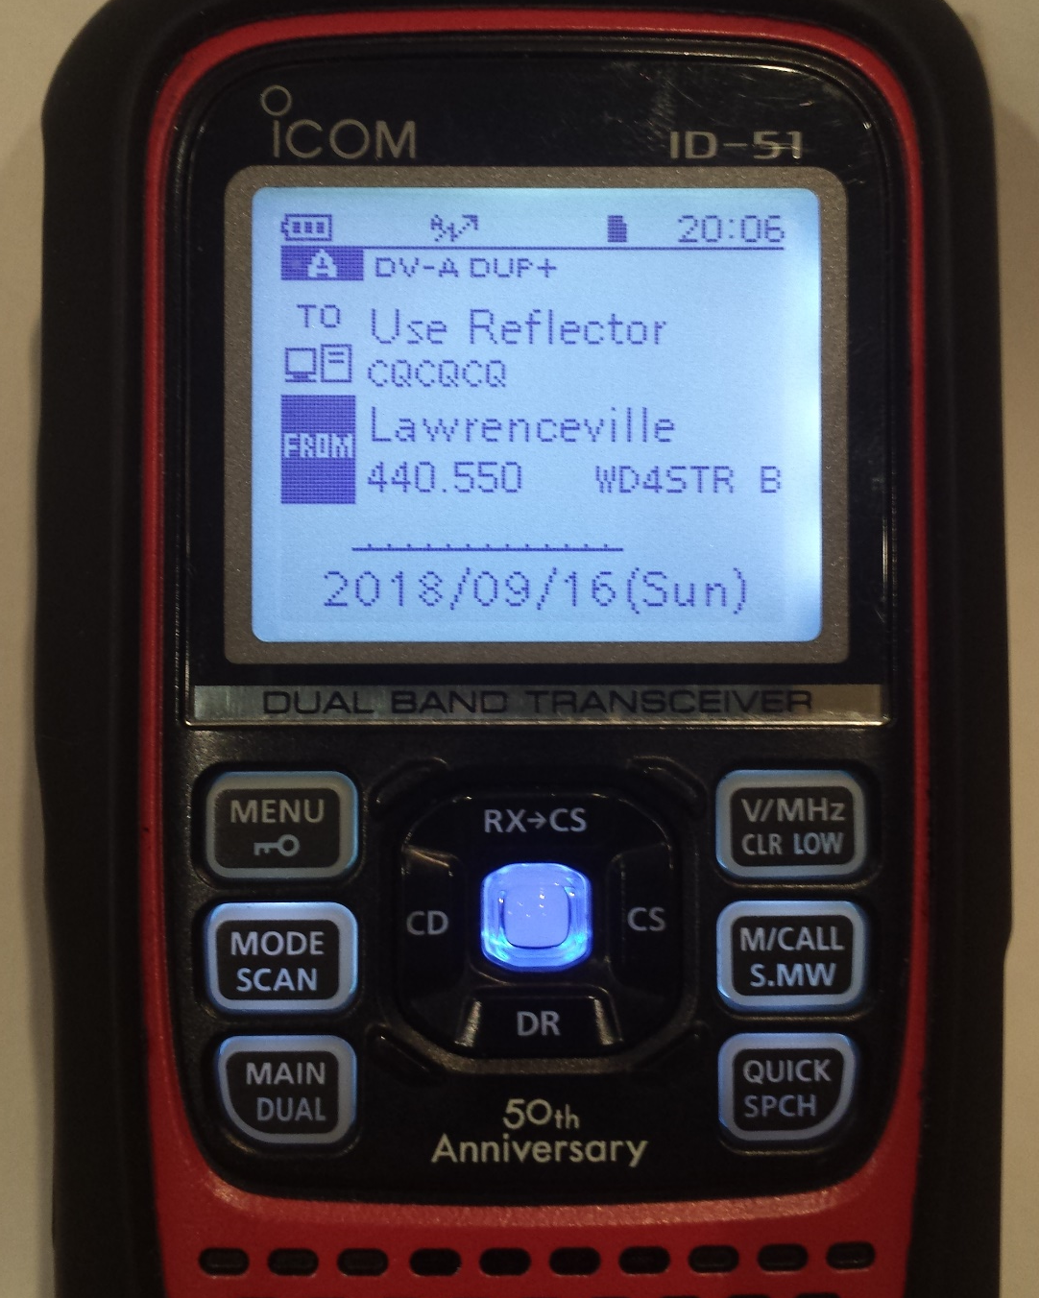
Using DR Mode
DR Mode (Digital Repeater Mode) allows quick selection of repeaters and using linking commands without custom programming
Uses stored database of repeaters in memory and on SD card
Press and hold DR below blue center button to activate DR Mode
FROM – Sets local repeater you are using
TO – Determines what you want to do with your signal (talk, link, unlink)

Slide 12
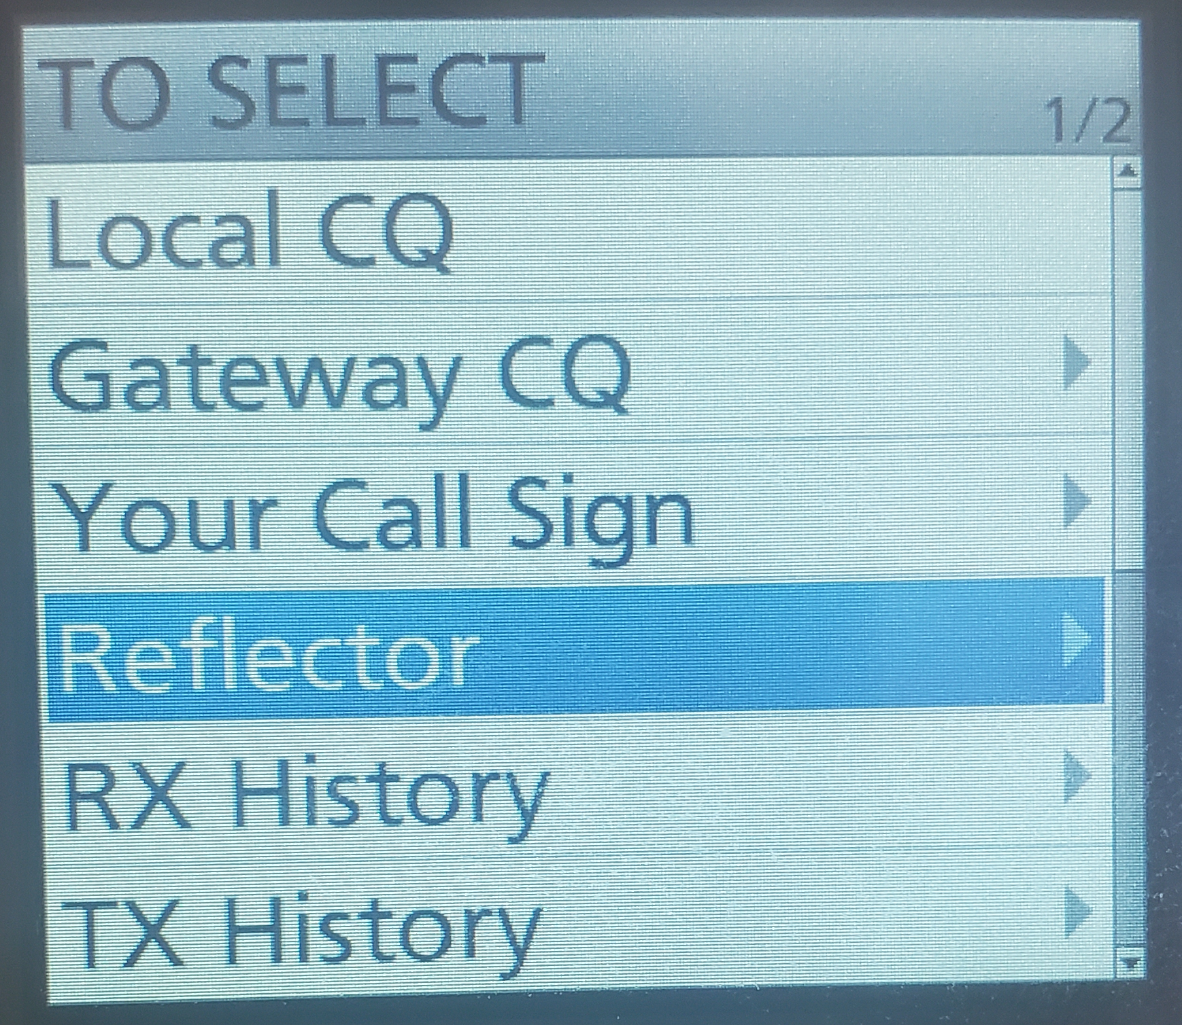
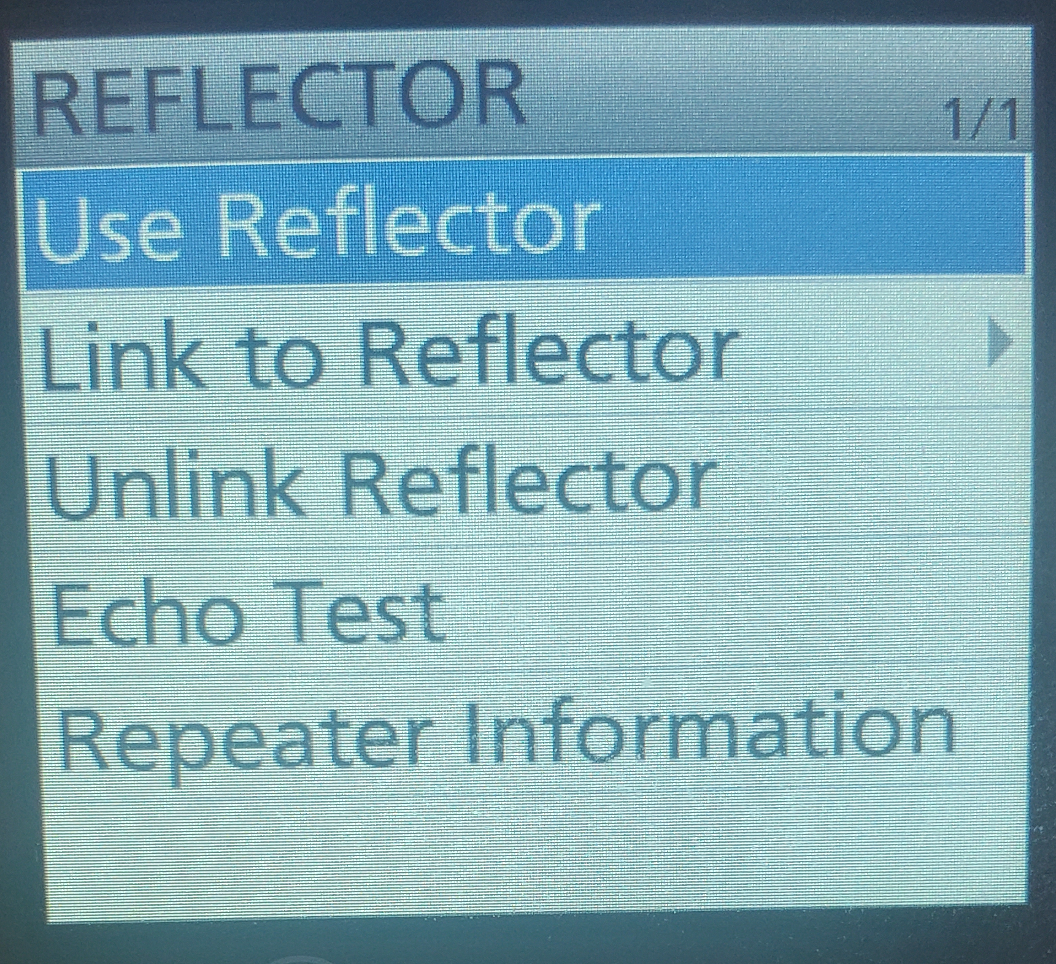
DR Mode TO Options
Always set TO to “Use Repeater/Use Reflector”

Slide 13
Why Update Memories?
Current generation D-STAR radios come pre-loaded with an international database of repeaters
Pre-loaded data is great to get on the air out of the box, but does not have most current list of repeaters
Updating memories can provide more repeaters in an area
Sources of updated repeater data
    DstarInfo.com
    RT Systems software (Uses DstarInfo.com data)

Slide 14
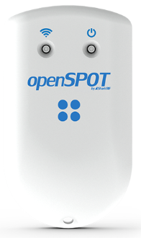
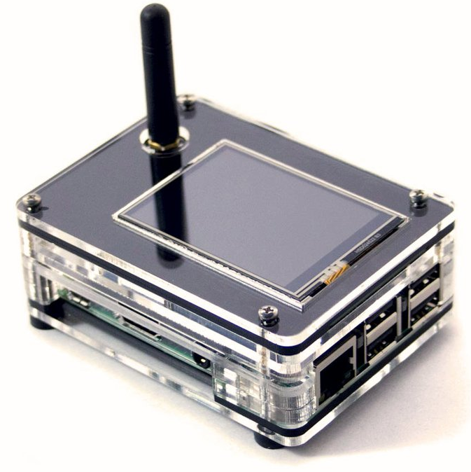
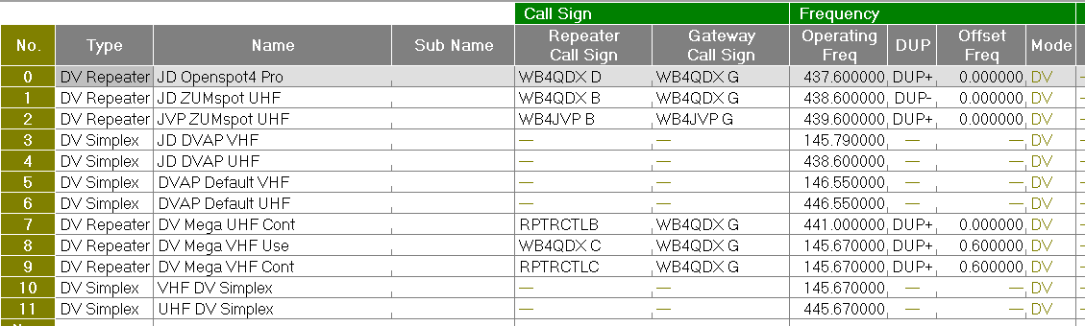
What About Hotspots?
Manual programming set RPT2 with “callsign_G”, +/- DUP and zero offset
Select hotspot in FROM settings
Use TO in DR Mode to connect to reflectors

Slide 15
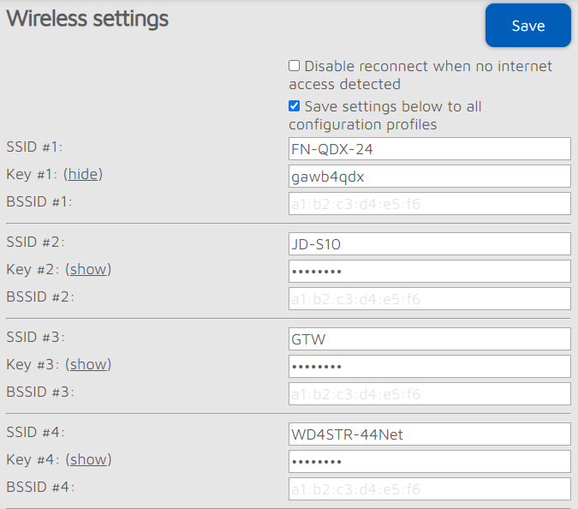
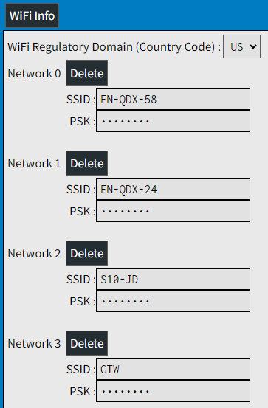
Tips and Caution Using Hotspots
Only have ONE hotspot powered at a time
Never have two hotspots running on the same frequency (causes unintentional linking two reflectors together!)
Program multiple Internet sources in Hotspot in order of preference

Slide 16
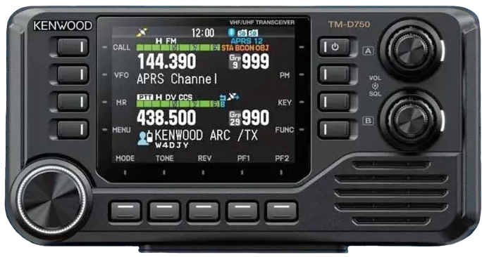
New DSTAR radios coming soon
Prototype shown at Dayton Hamvention in April, 2025
Received FCC approval January 23, 2026, availability/price ????
Dual band 144. 220, 430 Tx/Rx, Airband Rx
MicroSD card
Built-in GPS and speaker in head
USB-C on head and radio body for DSTAR data
Supports both APRS and DSTAR data
KISS TNC, 6-pin data jack on radio body
Color LCD screen
Bluetooth and Wireless LAN (802.11 a/b/g/n/ac)
1000memories, 1500 repeater list, 30 hotspot lists
Simultaneous reception of two DSTAR signals
Kenwood TM-D750A
Dual Band Mobile

Slide 17
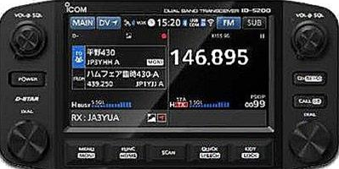
New DSTAR radios coming soon
Announced at Tokyo Ham Fair , August 2025
144/430 Dual-band Tx/RX with Airband Rx
Touchscreen, color display
Simultaneous FM/DV with dual DV
Bluetooth and Wi-Fi connectivity
Picture Tx/Rx capability
Micro SD
Internal GPS on head
KISS TNC ???
Availability, price ???
Icom ID-5200A
Dual Band Mobile

Slide 18

Questions?

